Slide 1
The logic of pedagogical knowledge in action (moral agency)
Fundamental themes in stories early-childhood-education-pedagogues live by
dr. Jan Jaap Rothuizen
Notes:
Knowing what to do when you don´t know what to do
ECE = close to everyday-life; focus on the child´s being in the world (the basics/summits of life)
School: integrating knowledge og skills with this basis & develop it further

Slide 2
Bodies of knowledge at play in early childhood education
Knowledge for educators - knowledge of educators (Fenstermacher 1994)
Objectivism – subjectivism → beyond objectivism and relativism (Bernstein)
Pedagogy (Pädagogik, Erziehungswissenschaft) as a science on its own -not only as a field of investigation for other (educational) sciences.
Pedagogy as a science characterized by an educational interest: the interest in good education. The question of good education is at the core of this science. Good education is not a fact but a discussion (conversation) that requires interpretation and concepts (hermeneutic competence) . Pedagogy is a project, not an object governed by laws.

Slide 3
A narrative approach
5 places,
about 30 educators,
3-5 at a time,
75 sessions,
more than 200 stories (written, told)
Narrative analysis (Arthur W. Frank , Jean Clandinin, Max van Manen)
Notes:
Frank-socio-narratology, Clandinin: Dewey, van Manen: phenomenology, Cheryl Mattingly, Catherine Riesmann, H-G Gadamer

Slide 4
New companions
Viggo is a boy who is not very flexible. He would prefer to completely control what is going to happen and hits and kicks when he feels under pressure.
He is therefore not particularly well-liked in the group. So we are working on changing it and have decided that we will work with changing companionship on our walks. The easiest thing is if he is allowed to go with the best friend Ole, but I have decided that he must go with Jonas the next time.
There is resistance from both boys, so I decide to go between them. When we go home again, I say to the boys that now they have to go together until we get to the local supermarket and then we will talk about how it was. Passing the local supermarket , the boys think it's ok and we choose to go the same way to the railway. Passing the railway they still think it's ok and the rest of the trip home to the kindergarten they shift kicking stones on the gravel path. They laugh and enjoy themselves.

Slide 5
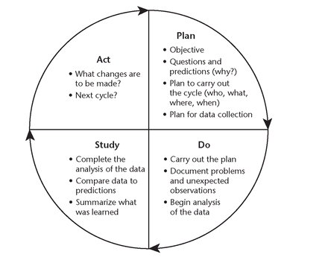
Understanding the logic of the knowledge at play
The objectivating approach:
But:
Pedagogues do plan and act, but there are also many pedagogical important interactions that require spontaneous responses:
what is pedagogical relevant in ece is close to everyday-life -not a separate space of educational interventions
The childs´ unpredicatability is at least as important as the childd predictability

Slide 6
Pedagogical practice as storied
Pedagogues (Early childhood educators) enact stories
That means in their actions they enact plots -they do not know the story beforehand, but they have a more general sense of possible stories.
There is a pedagogical ”genre”, that means: we can recognize stories as pedagogical stories because of the kind of plot that is enacted in them.
(romantic stories: (how/when) do they get each other?
detectives: who is (not)the murderer and how did (s)he plan and hide the traces)

Slide 7
The field for pedagogical plots and for pedagogical conversations about good pedagogy
Purposes
Civilization
(participate in sommunities of free citizenst
Subjectification
(coming into being
as person)
Socialization
(become like the others)
Means
Wondering about children
Here the plot is unfolded in unpredicatble movements
Good pedagogy?
Pedagogical intentions

Slide 8
The narrative plot model and the systematics of storytelling and conversation can supplement the systematics of plan-do-check-act circles
Implications for education?

